Slide 1
PROTEOME-WIDE SCREEN FOR RNA-DEPENDENT PROTEINS non-synchronized A549 cells datascience SS22, project 3 group 4
Greta Karathanos, Khalida Dushimova, Madleen Piegsa, Richard Langi
Notes:
14

Slide 2
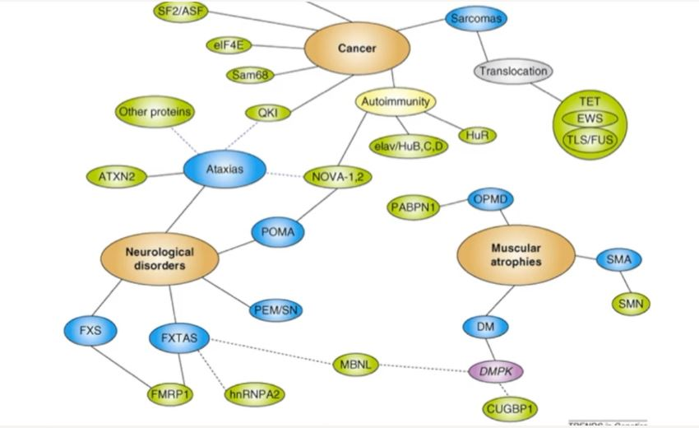
BIOLOGICAL MEANING
Source: Introductory video by M.Caudron-Herger
1
Data Analysis Project SS22
18.07.2022
Notes:
14

Slide 3
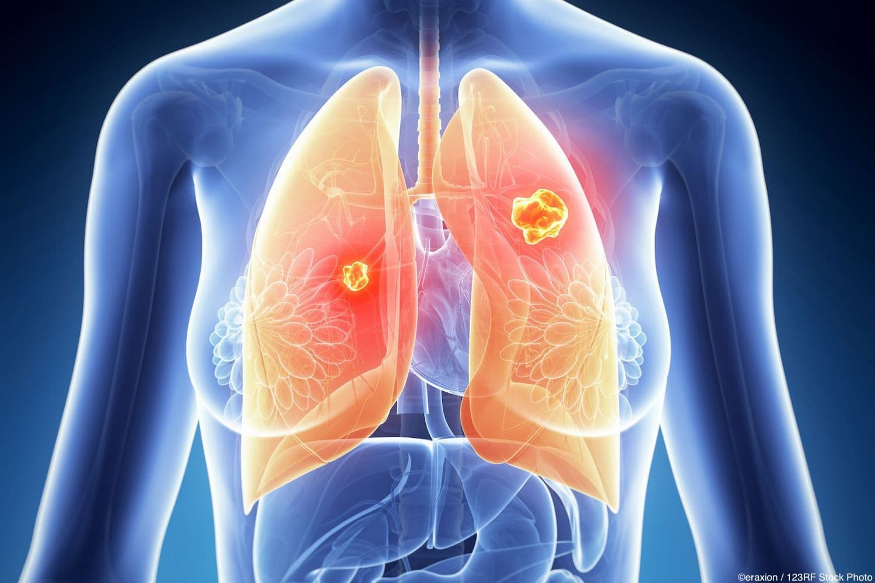
BIOLOGICAL MEANING
Source: ASCO 2018 NSCLC: The ASCO18 Lung Cancer Track Summarised (medi-paper.com)
1
Data Analysis Project SS22
18.07.2022
Notes:
14

Slide 4
MILESTONE 1: RESTRUCTURING THE DATA
BEFORE: RNASE + CTRL GROUP IN ONE DF
Human protein | Fraction 1 Rep.1 Ctrl | Fraction 1 Rep.1 RNase | Fraction 1 Rep.2 Ctrl | Fraction 1 Rep.2 RNase | Fraction 1 Rep.3 Ctrl | Fraction 1 Rep.3 RNase
SPB6_HUMAN | x | x | x | x | x | x
CRYAB_HUMAN | x | x | x | x | x | x
VIGLN_HUMAN | x | x | x | x | x | x
1
Data Analysis Project SS22
18.07.2022
Notes:
14

Slide 5
MILESTONE 1: RESTRUCTURING THE DATA
AFTER: RNASE DF AND CTRL DF
Fractions | SPB6_HUMAN_REP_1 | SPB6_HUMAN_REP_2 | SPB6_HUMAN_REP_3 | CRYAB_HUMAN_REP_1 | CRYAB_HUMAN_REP_2 | CRYAB_HUMAN_REP_2
Fraction_1 | x | x | x | x | x | x
Fraction_2 | x | x | x | x | x | x
Fraction_3 | x | x | x | x | x | x
Fractions | SPB6_HUMAN_REP_1 | SPB6_HUMAN_REP_2 | SPB6_HUMAN_REP_3 | CRYAB_HUMAN_REP_1 | CRYAB_HUMAN_REP_2 | CRYAB_HUMAN_REP_2
Fraction_1 | x | x | x | x | x | x
Fraction_2 | x | x | x | x | x | x
Fraction_3 | x | x | x | x | x | x
1
Notes:
14

Slide 6
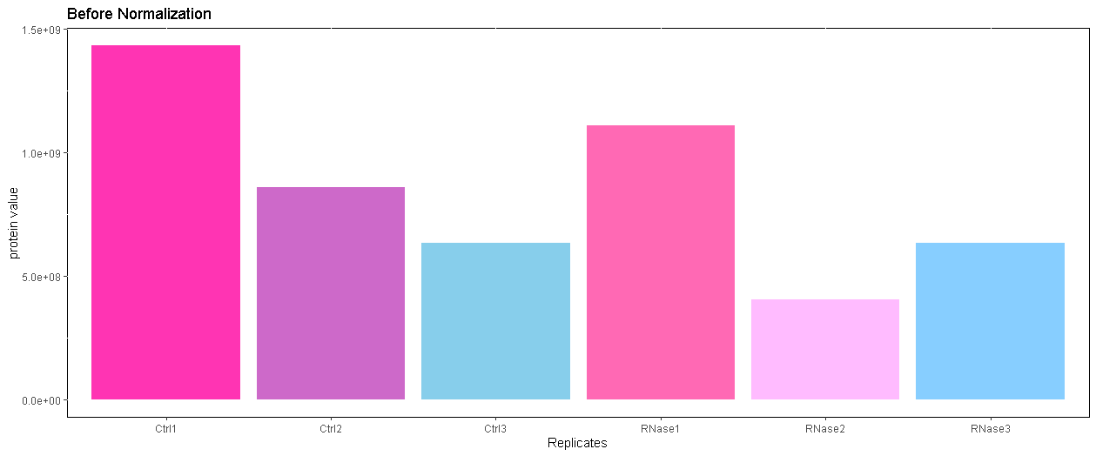
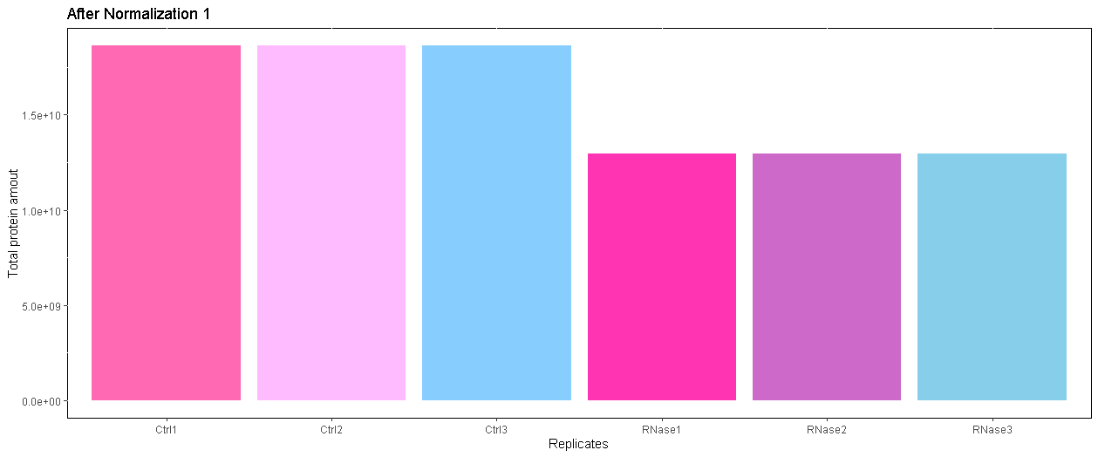
MILESTONE 2: FIRST NORMALIZATION
Objective: → The values have to be comparable and therefore the total amount of protein has to be equal for all replicates
BEFORE FIRST NORMALIZATION AFTER FIRST NORMALIZATION
1
Data Analysis Project SS22
18.07.2022
Notes:
14

Slide 7
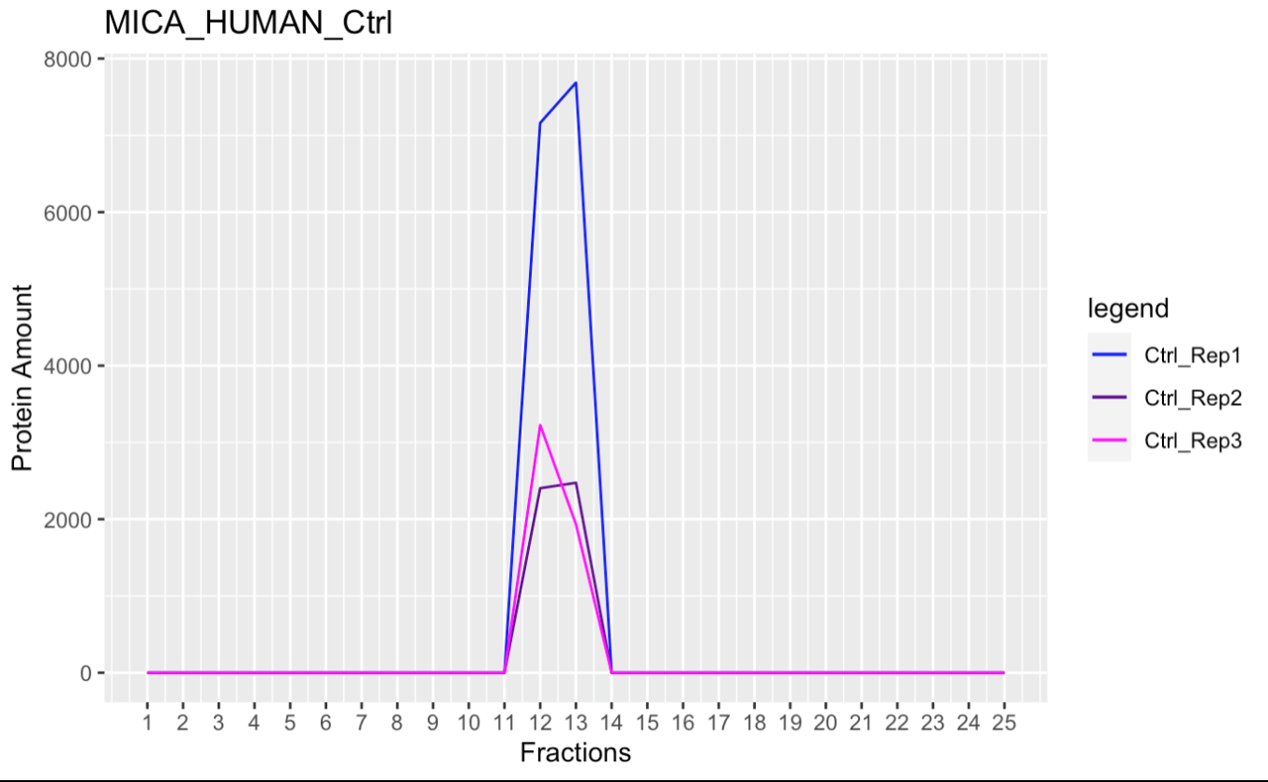
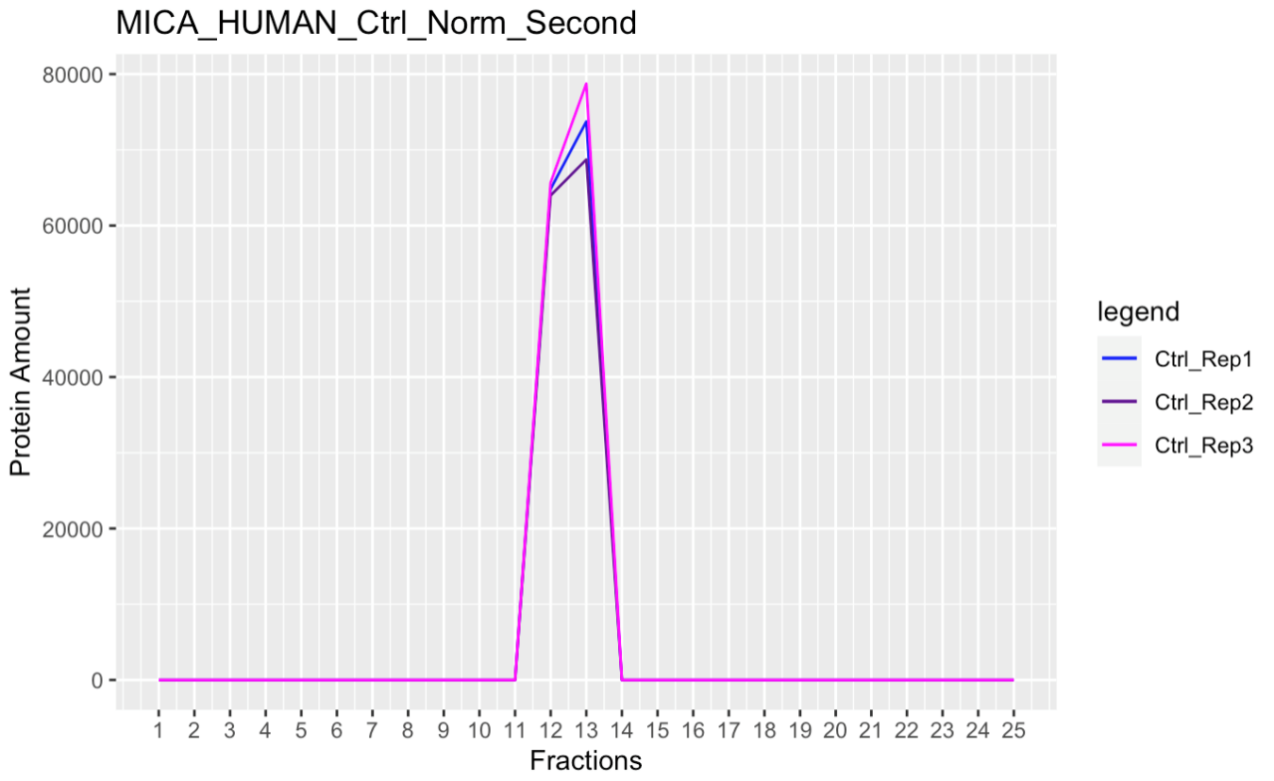
MILESTONE 2: SECOND NORMALIZATION
Objective: → Reduce the outliers with the antioutlier function
BEFORE SECOND NORMALIZATION AFTER SECOND NORMALIZATION
1
Data Analysis Project SS22
18.07.2022
Notes:
14

Slide 8
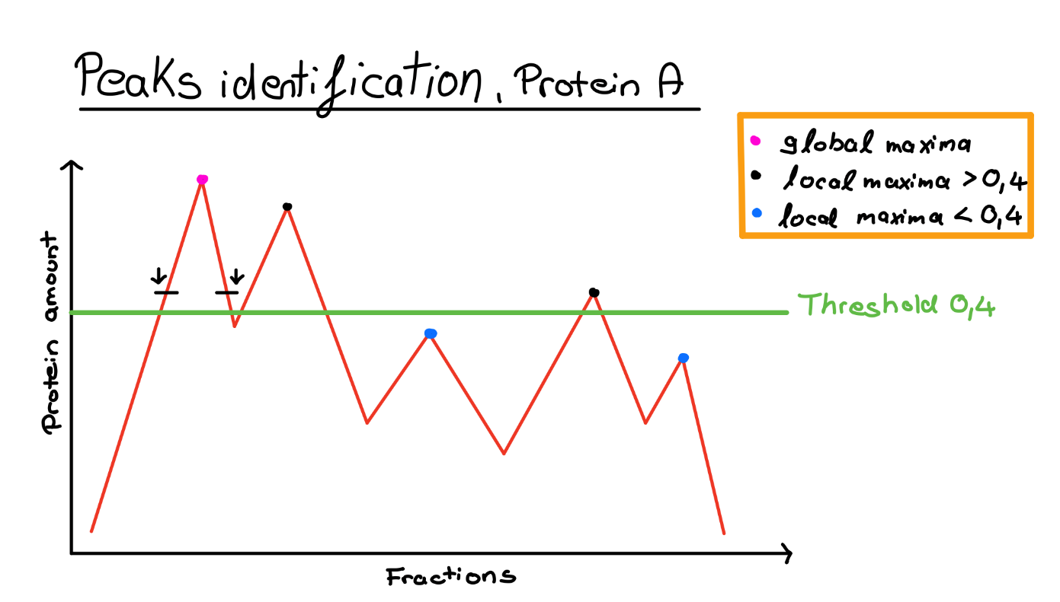
MILESTONE 3: PEAKS IDENTIFICATION
Objective:
Global and local maxima of RNase and Ctrl group
Input :
RNase and Ctrl group df after both normalizations
Output:
Number and location (Y-Shift) of global and local maxima (of different thresholds)
1
Data Analysis Project SS22
18.07.2022
Notes:
14

Slide 9
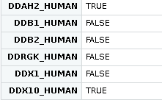
MILESTONE 4: T-TEST GLOBAL MAXIMA
Objective:
Determine if there is significant difference between Ctrl and RNase maxima
Global T-test results as first selection criterion
Input:
Y-shift values of global maxima of RNase and Ctrl group
Output:
True/False Df
1
Data Analysis Project SS22
18.07.2022
Notes:
14

Slide 10
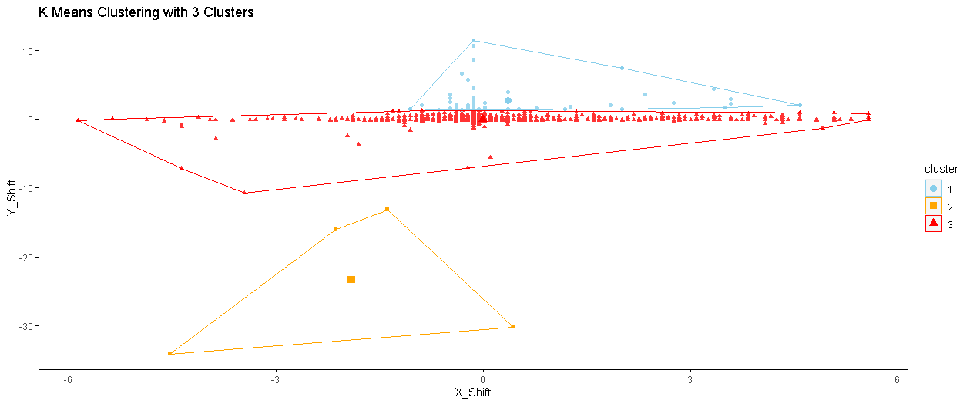
MILESTONE 5: K-MEANS CLUSTERING
Objective:
assigning each protein into clusters with regard to their shift characteristics (X- and Y-Shift) and assign a biological meaning to it (second criterion)
Input:
X- and Y-shift of Ctrl and RNase group
Output:
3 clusters
blue = RNA-dependent protein red + yelllow = RNA-independent protein
10
Data Analysis Project SS22
18.07.2022
Notes:
14

Slide 11
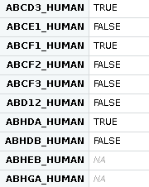
MILESTONE 6: T-TEST LOCAL MAXIMA
Objective:
Determine if t-test is significant (RNA-dependency) or not (RNA-independency)
result as third selection criterion
Input:
Y-shift values of local maxima of RNase and Ctrl group
Output:
Df showing if human protein is RNA-dependent or RNA-independent
11
Data Analysis Project SS22
18.07.2022
Notes:
14

Slide 12
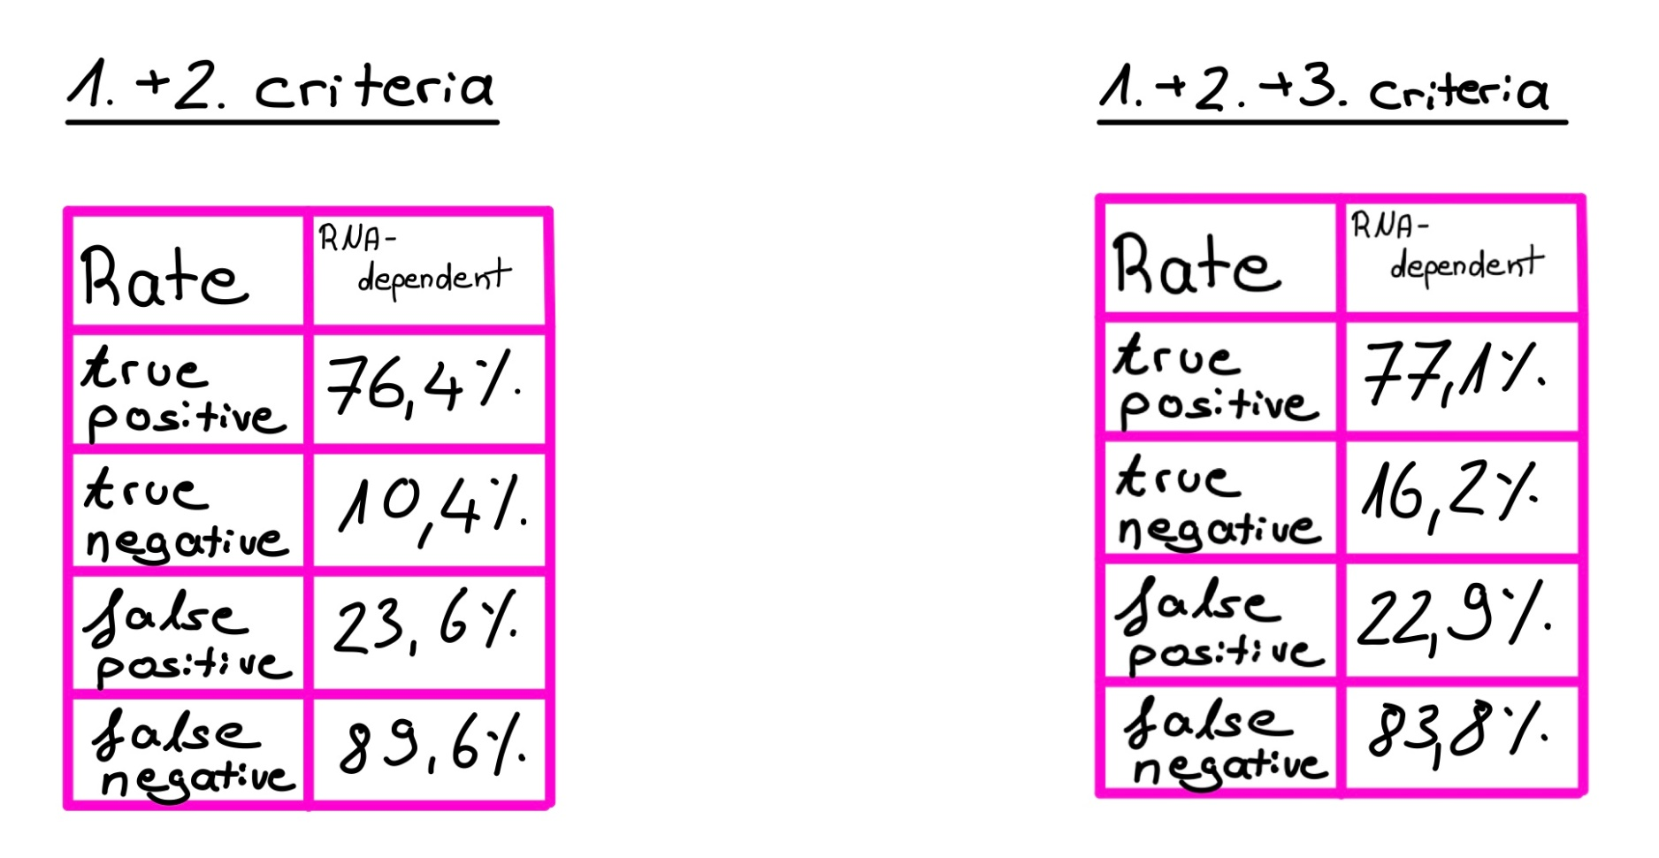
MILESTONE 7 : TRUE/FALSE RATES
Objective: → Comparison of our true/false rates with and without the third criterion
12
Data Analysis Project SS22
18.07.22
Notes:
14

Slide 13
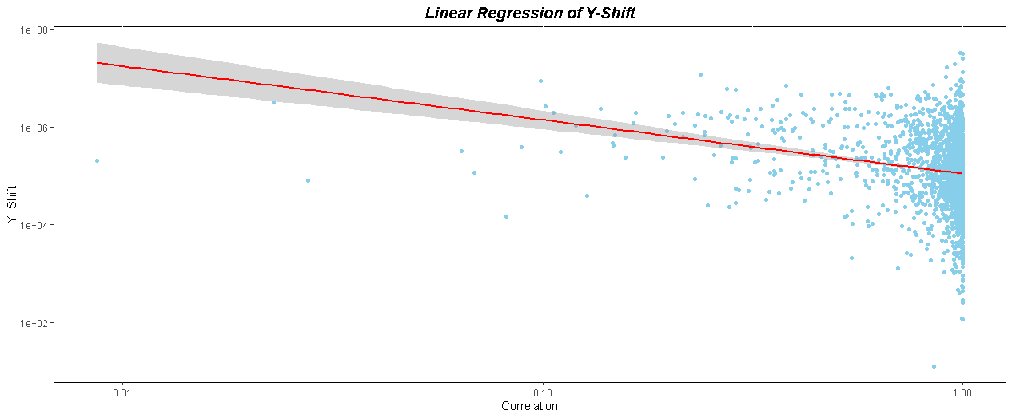
MILESTONE 8: LINEAR REGRESSION 1
Objective:
prediction of Y-Shift with correlation
Input:
correlation and Y-Shift values of RNase and Ctrl group
Output:
1 linear equation and calibration line
13
Data Analysis Project SS22
18.07.2022
Notes:
14

Slide 14
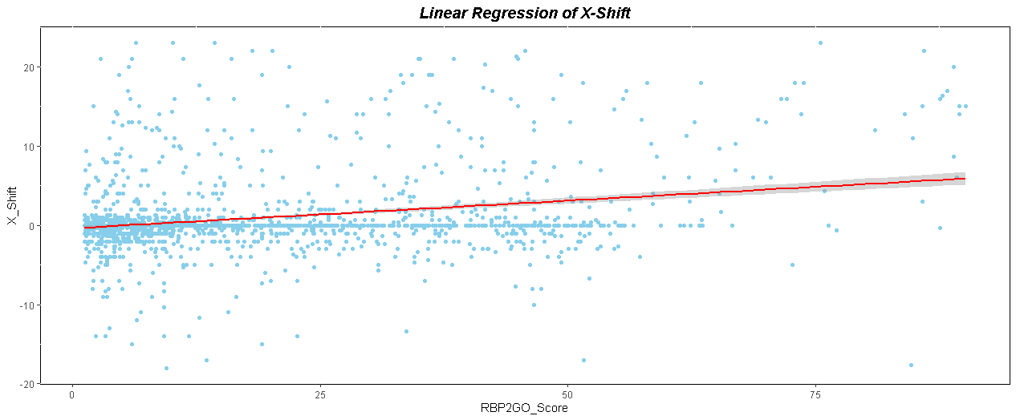
MILESTONE 8: LINEAR REGRESSION 2
Objective:
prediction of X-Shift with RBP2GO_Score of external database
Input:
RBP2GO_Score values and X-shift values of global and local maxima
Output:
1 linear equation and calibration line
14
Data Analysis Project SS22
18.07.2022
Notes:
<number>

Slide 15
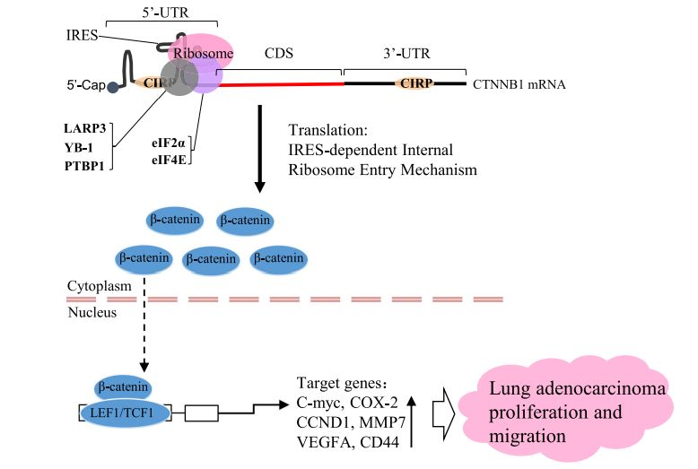
BIOLOGICAL MEANING
https://media.springernature.com/lw685/springer-static/image/art%3A10.1186%2Fs13046-021-02080-9/MediaObjects/13046_2021_2080_Fig8_HTML.png
14
Data Analysis Projekt SS22
18.07.2022

